Slide 1
HS2061
Selected Topic
Information Technology
Project Management Methodologies
Traditional VS Agile
Information Systems Project Management
1

Slide 2
HS2061
Introduction & Outline
Introduction
Student Name : Tanvir Rahman Tonoy
Student ID : STN3121
Outline
Traditional
&
Agile
Methodology
References
________
Q&A
Comparative Analysis
Critique Article 1
Critique
Article 2
Information Systems Project Management
2

Slide 3
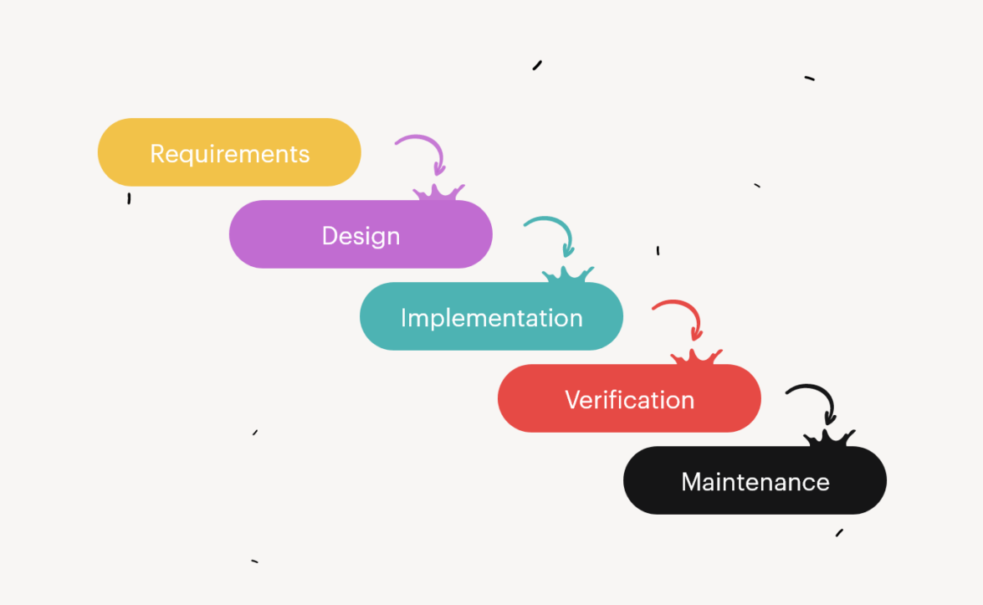
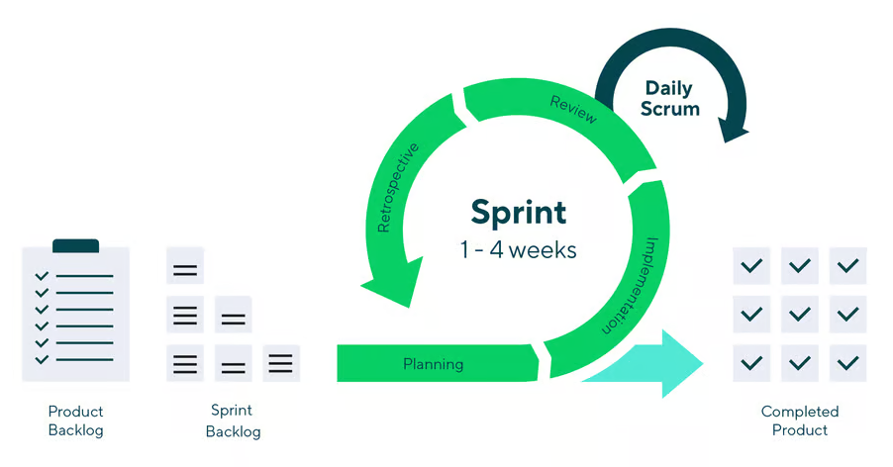
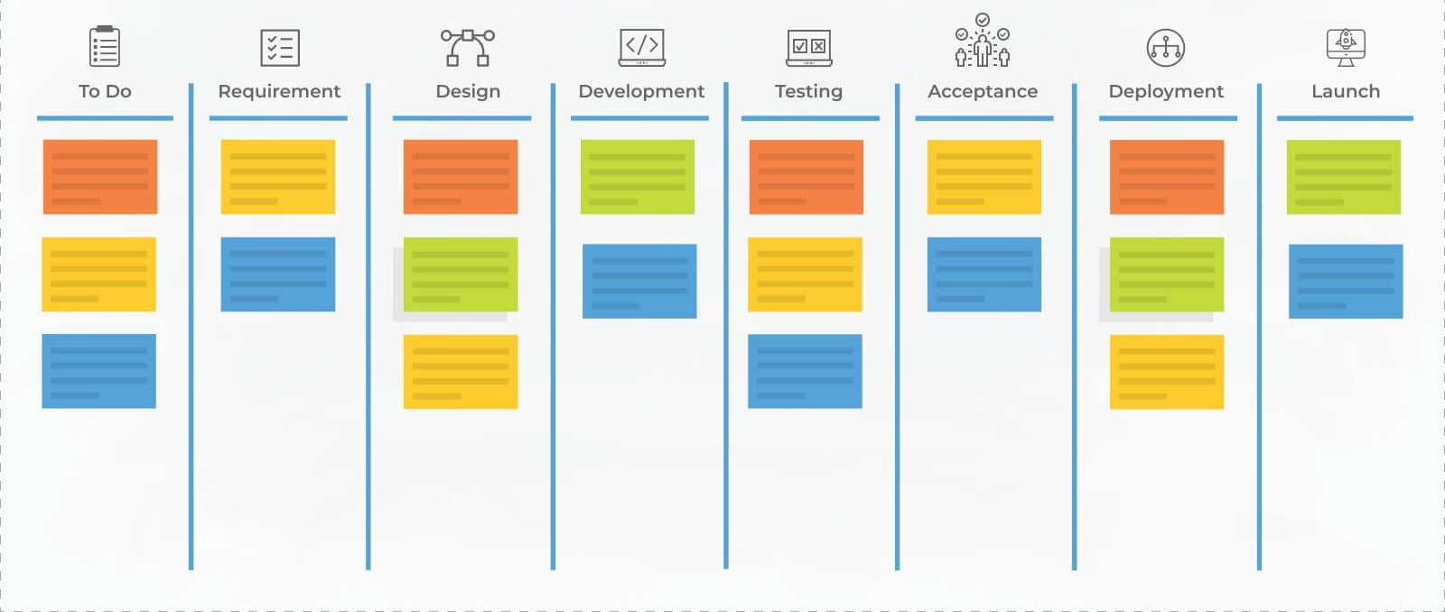
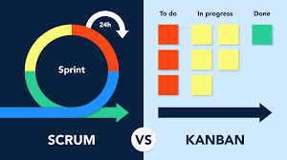
Waterfall & Agile
Waterfall
Agile
VS
Source : Kitchen.co
Source : www.wrike.com
Iterative sprints
Requirements evolves
Lower risk
issues caught early
Best for: dynamic needs, fast-changing markets
Sequential,
Requirements fixed
One final delivery
High risk rate
Best for: stable needs, fixed budgets
Phases: Requirements → Design → Build → Test → Deploy → Maintain
Information Systems Project Management
3

Slide 4
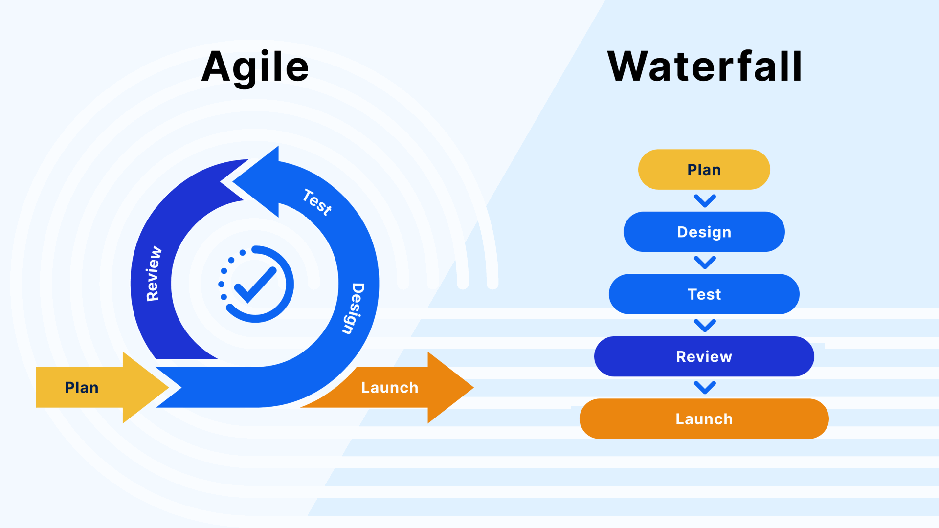
Key Differences at a Glance
Dimension | Waterfall | Agile
Approach | Linear & sequential | Iterative & incremental
Flexibility | Low – changes costly mid-project | High – changes welcomed
Customer Feedback | End of project only | After every sprint
Delivery | One final product | Incremental, usable releases
Risk Profile | High risk at delivery | Risk spread across iterations
Team Structure | Functional departments | Cross-functional teams
Best Fit | Stable scope | Evolving scope / dynamic markets
Source : www.easy8.com
Information Systems Project Management
4

Slide 5
Article Critique 1
Fagarasan et al. , 2021
Purpose
Key Findings
Analyse Agile (Scrum & Kanban) as a more viable alternative to Waterfall for IT project delivery
• Agile 3× more successful outcomes than Waterfall
• Scrum dominates with 58% adoption rate
• Iterative delivery significantly reduces end-of-project risk
Strengths
Limitations
• Practical Scrum case study (3-month project)
• Clear comparison metrics: scope, time, cost, ROI
• Covers both Scrum & Kanban in detail
• Limited to IT/software sector only
• No quantitative data from original projects
• Excludes hybrid methodology analysis
Information Systems Project Management
5

Slide 6
Article Critique 2
Ghena et al. (2023)
Purpose
Key Findings
Compare Waterfall & Agile in the power tools industry; survey of 30 engineers across Industry 4.0 & 5.0 context
• 67% of engineers prefer Agile for power tool projects
• Hybrid models widely used (27%)
• Waterfall still relevant for regulated, fixed-budget projects
Strengths
Limitations
• Primary research (survey + literature review)
• Industry 4.0/5.0 context is highly current
• Clear applicability criteria for method selection
• Small sample: only 30 engineers
• Focused on power tools industry – limited generalisability
• Subjective survey responses may introduce bias
Information Systems Project Management
6

Slide 7
References
Holmes Institute Adapted Harvard Referencing
1. Fagarasan, C., Popa, O., Pisla, A. & Cristea, C. 2021, 'Agile, waterfall and iterative approach in information technology projects', IOP Conference Series: Materials Science and Engineering, vol. 1169, no. 1.
https://www.proquest.com/scholarly-journals/agile-waterfall-iterative-approach-information/docview/2561948753/se-2?accountid=30552
2. Ghena, M.F. & Ghiculescu, L.D. 2023, 'Applicability of Waterfall and Agile Methodologies', FAIMA Business & Management Journal, vol. 11, no. 4, pp. 55–65.https://www.proquest.com/scholarly-journals/applicability-waterfall-agile-methodologies/docview/2903041222/se-2?accountid=30552
Information Systems Project Management
7

Slide 8
Thank You!
Questions & Discussion
8
Tanvir Tonoy · HS2061 · Holmes Institute · T1 2026

